Slide 1

Zonta Club of Naples Website
Emmanuela Fleurant

Slide 2
Objectives
Problem
The current website is outdated and does not meet the needs of the club or its members.
Objective
The objective is to create a simple and easy-to-use website for the Zonta Club of Naples. It should include the current pages on the website and a new feature/page which will include an E-Commerce, where users can buy merchandise and donate. The admin side should be able to be used without technical skills.

Slide 3
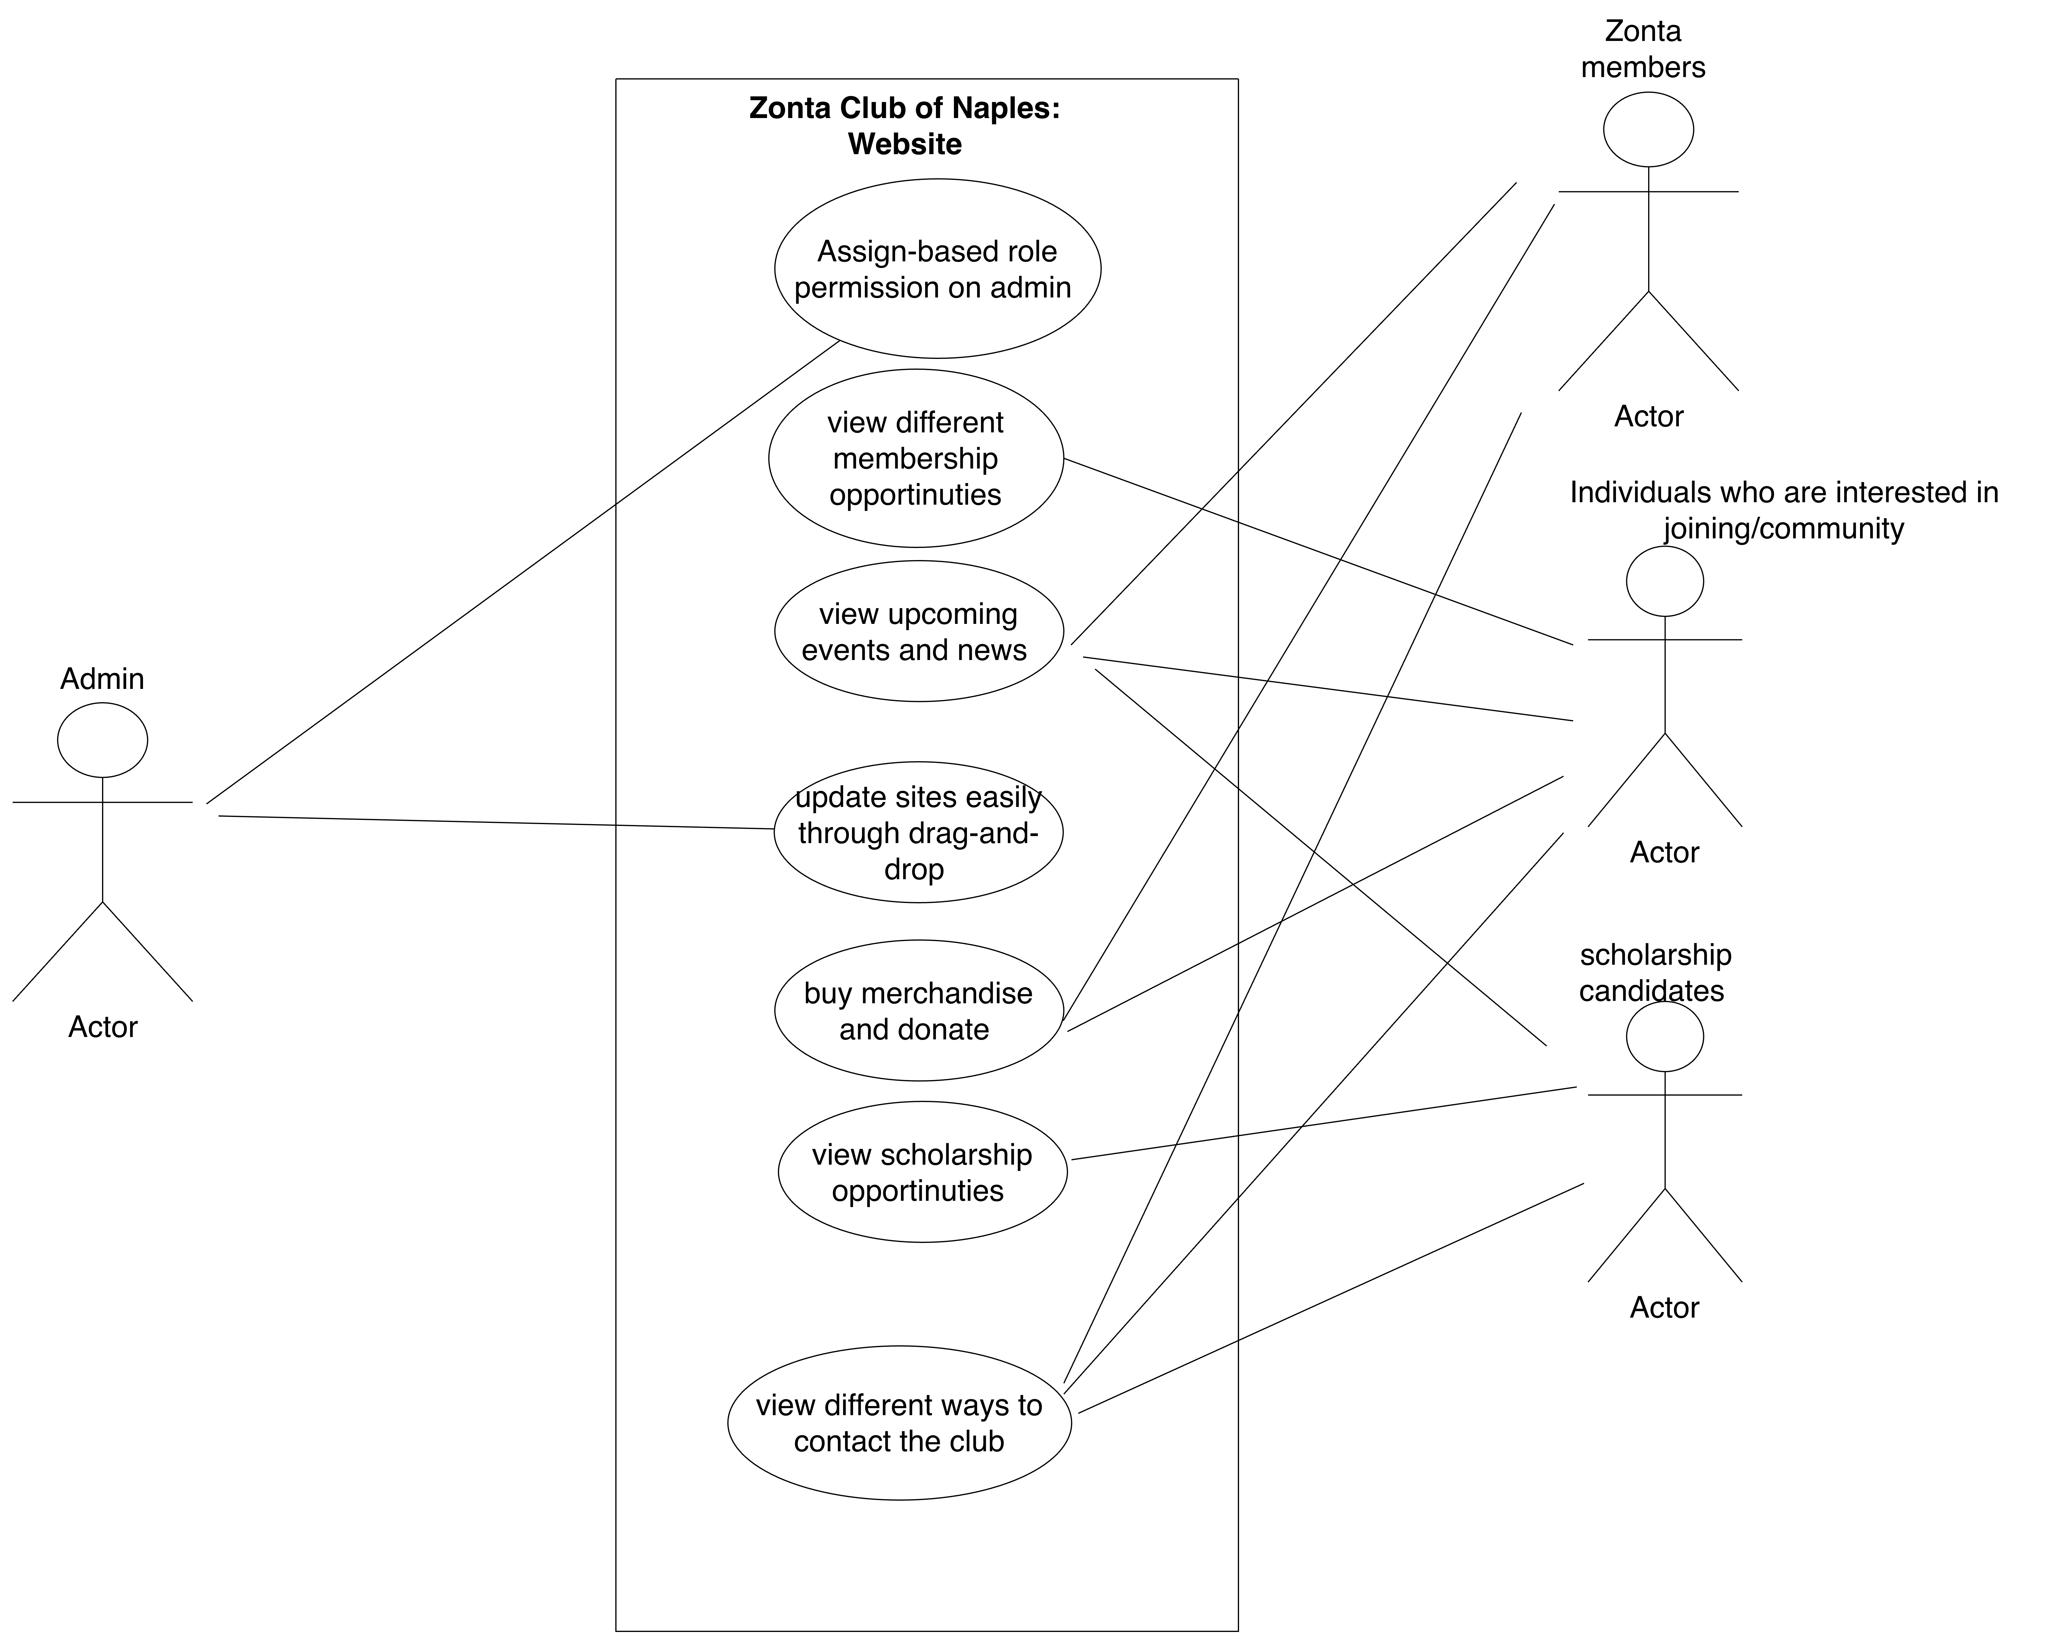
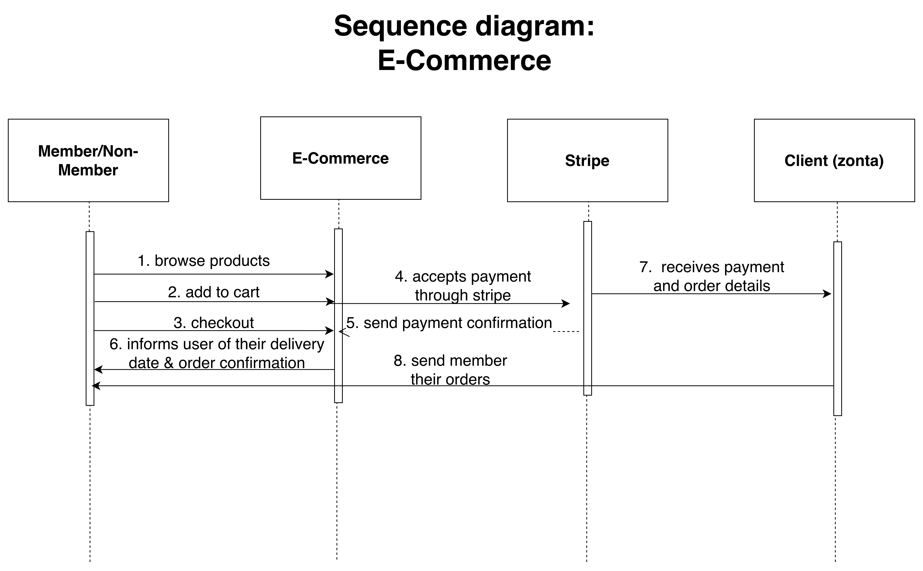
Design
Use case and sequence diagram

Slide 4
Implementation
Front-end
- React
Back-end
- Node.js and Express
Third party software
Stripe (handle payments)
Hosting and Deployment
GitHub – Used for version Control and deployment

Slide 5
Outcomes
https://github.com/emmafleurant/zonta-of-naples-website

Slide 6
Thank you !

